Slide 1
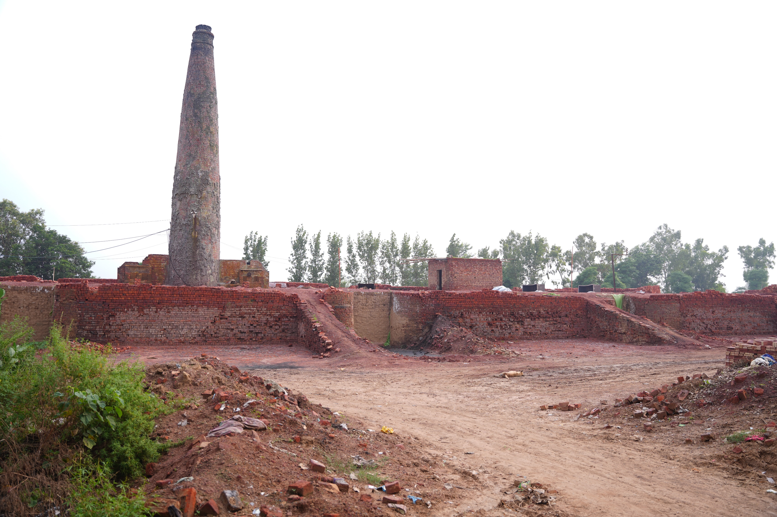
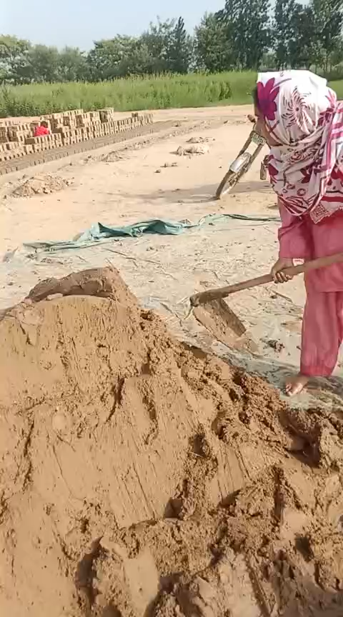

Lishba Maqbool (BS. D-Tech.)
Brick kiln worker’s daughter with a dream to become a D. Tech.
Poverty threatened her education after F.Sc Pre-Medical.
CHOPAN Trust stepped in, supporting her university education.
Today, she studies Dental Technology at Superior University.

Slide 2
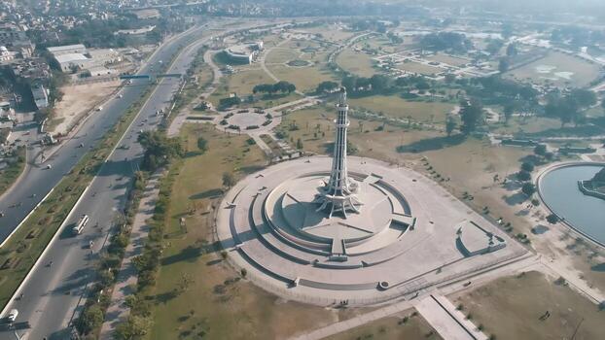
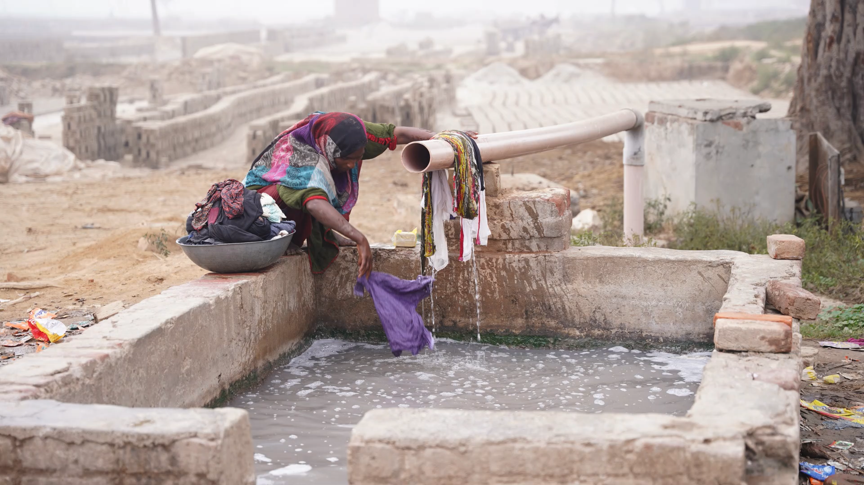
Behind every difficult home is a family longing on to hope.
A fragile home. A Simple life. A constant struggle.
When the surroundings are unsafe, even childhood becomes harder.
Dirty water and poor sanitation turn everyday life into a battle.
Poverty is not a choice. For many families, it is a daily reality
And! Behind every child is a dream worth protecting.
Every difficult story asks a simple question: Will someone care enough to help?

Slide 3
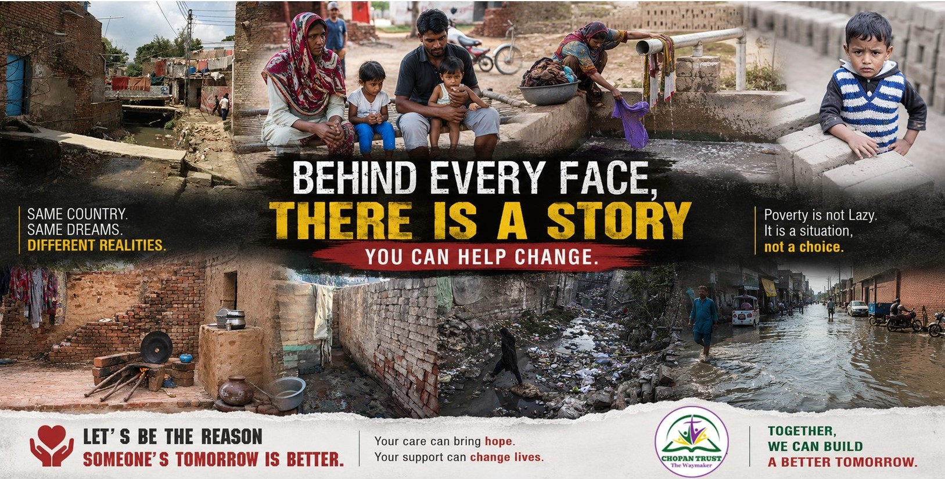

Slide 4

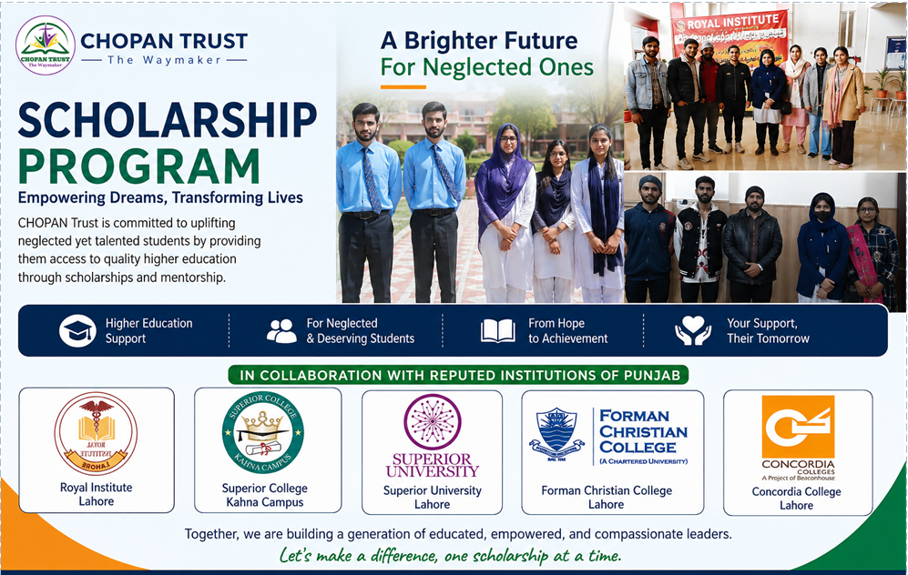
Giving
31
dreams, a chance to Shine

Slide 5


CHOPAN Trust
Believes
“One Word can touch a heart and transform a generation. Let God’s Word fill every classroom and every child with hope.”

Slide 6
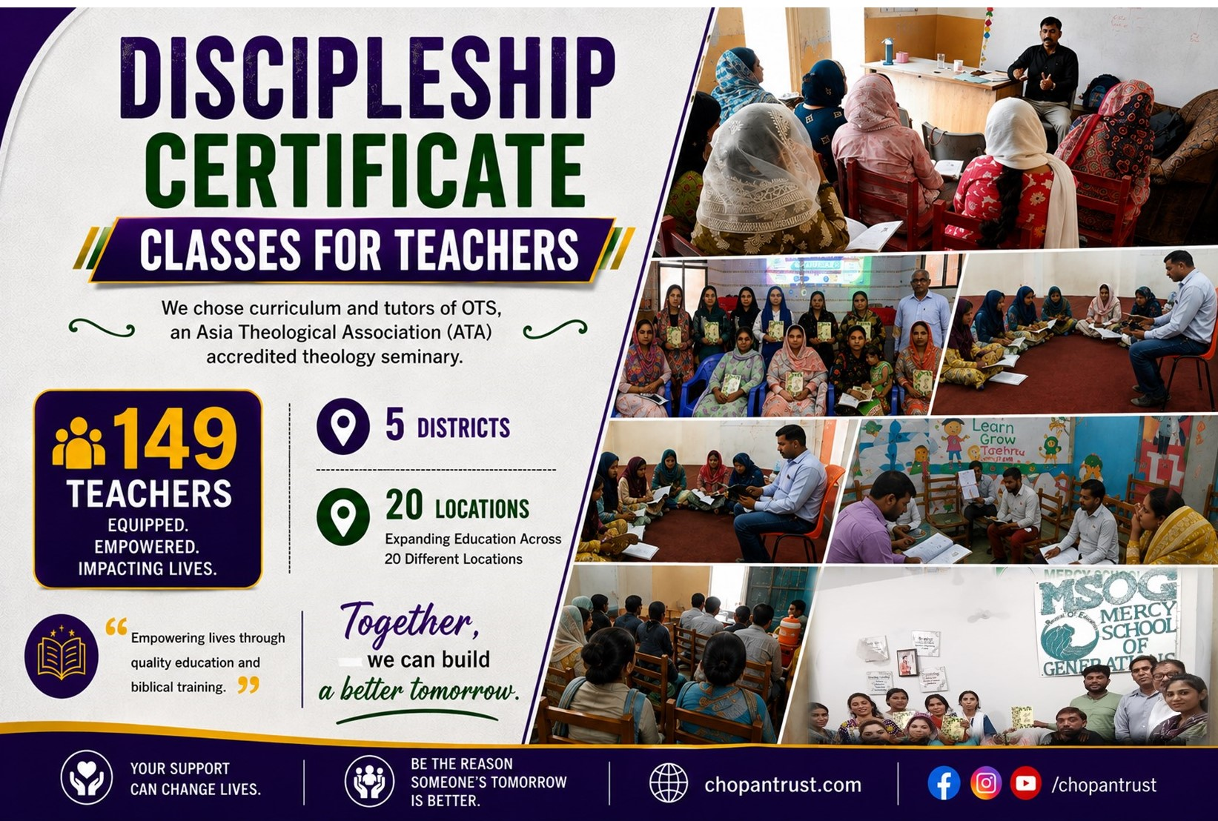

Slide 7
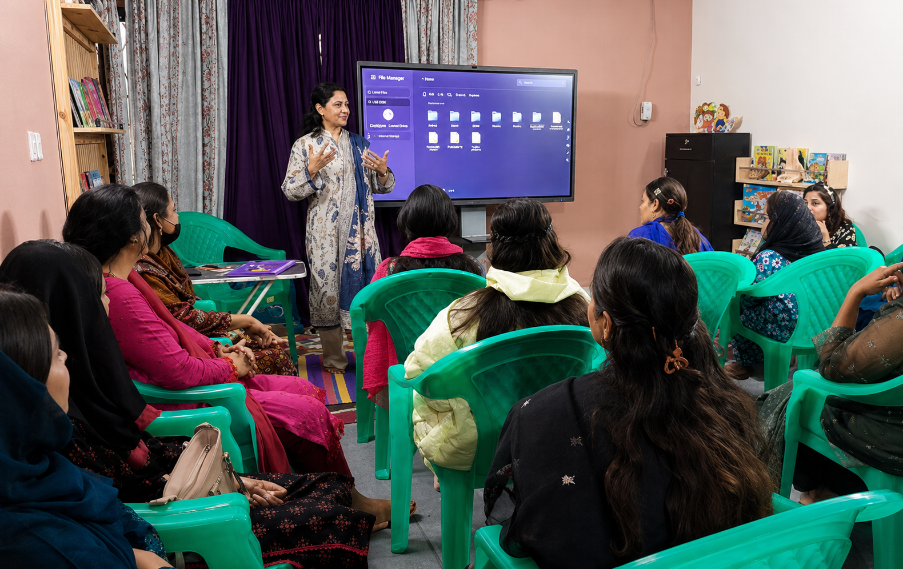
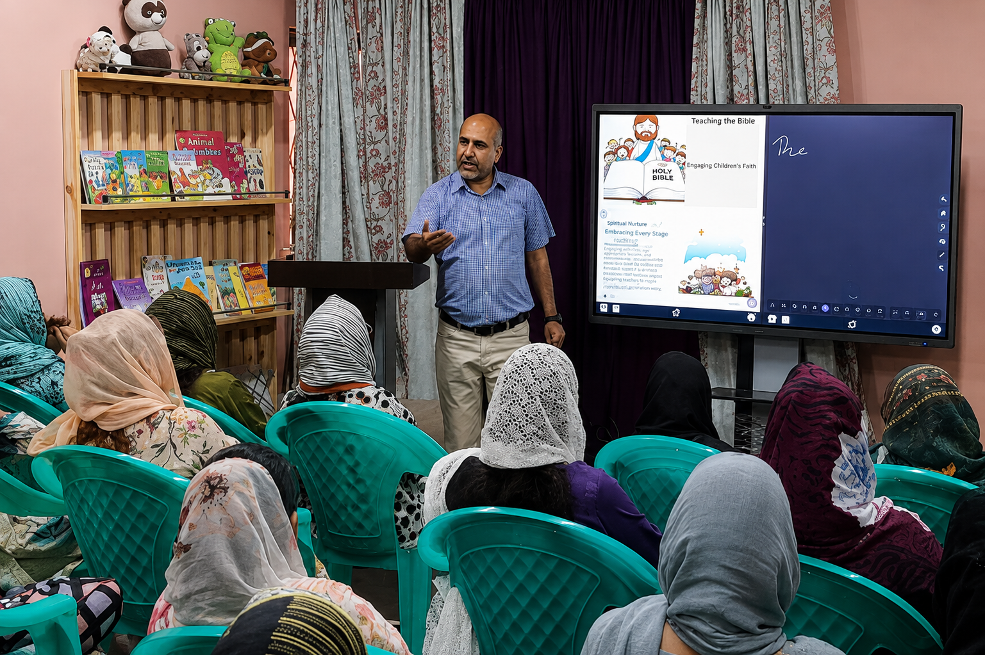

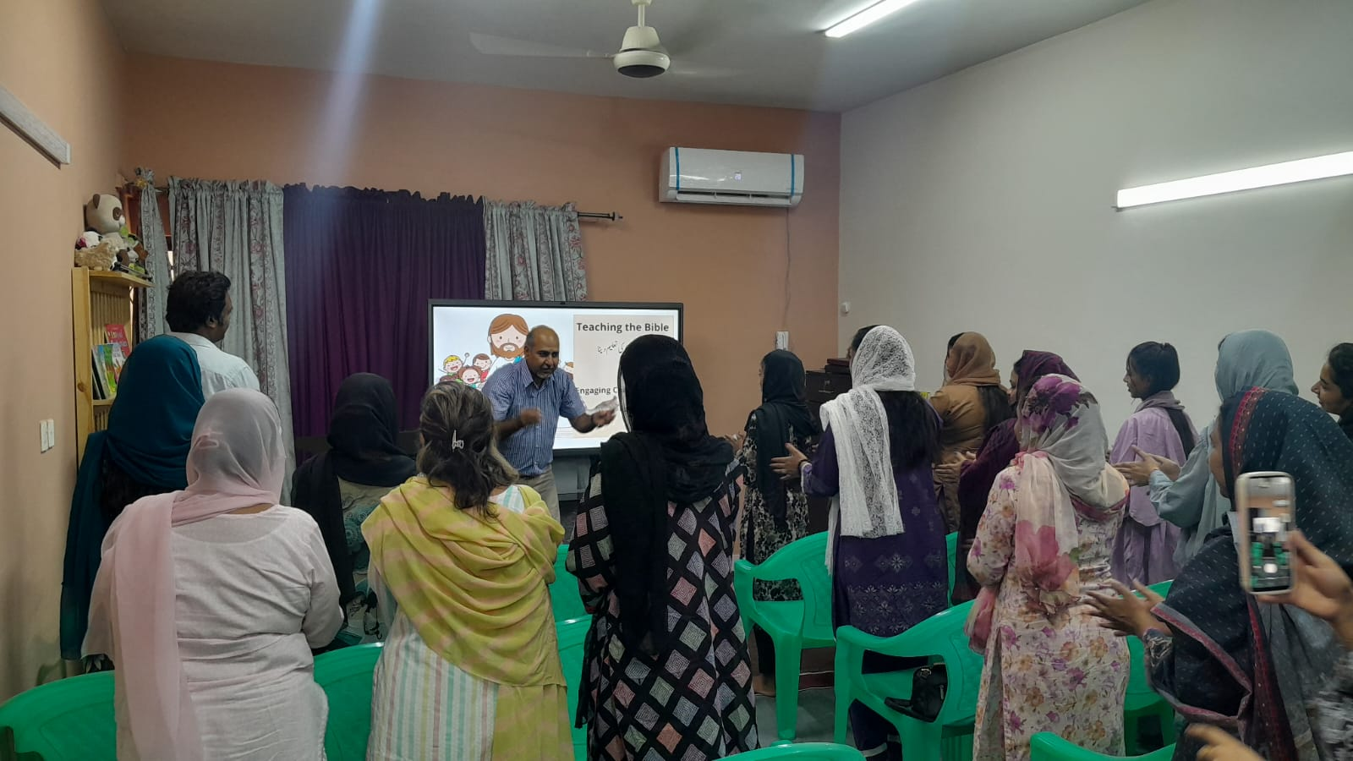
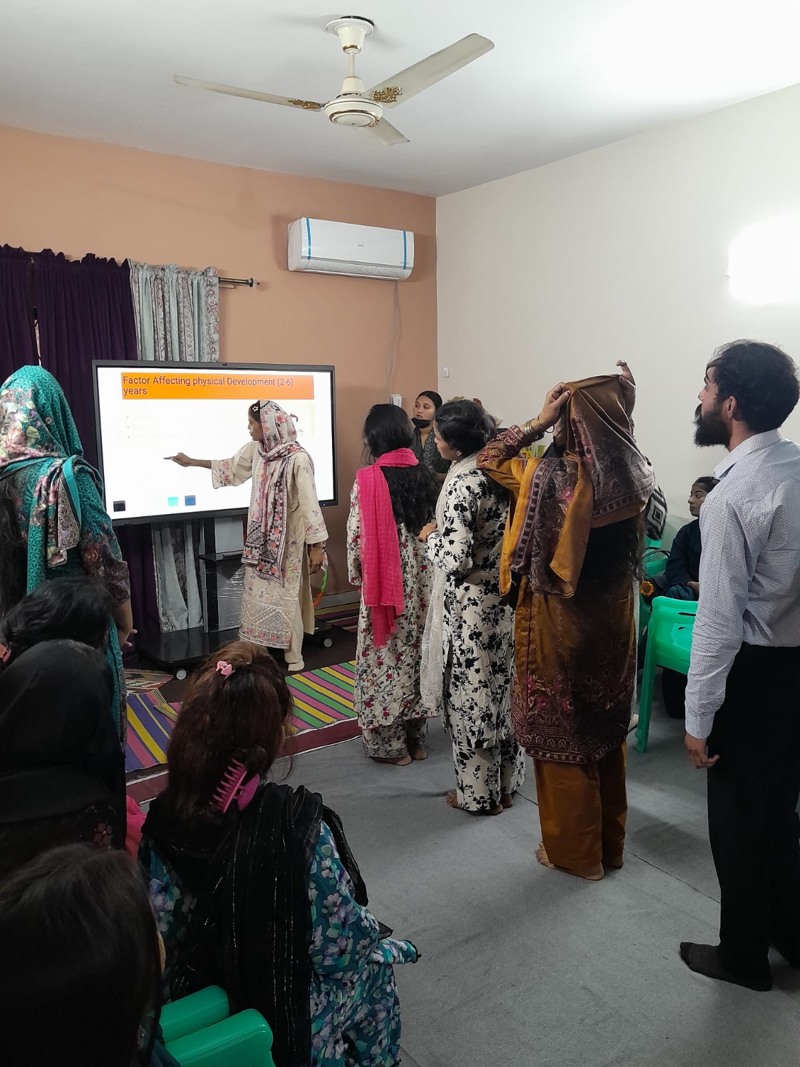
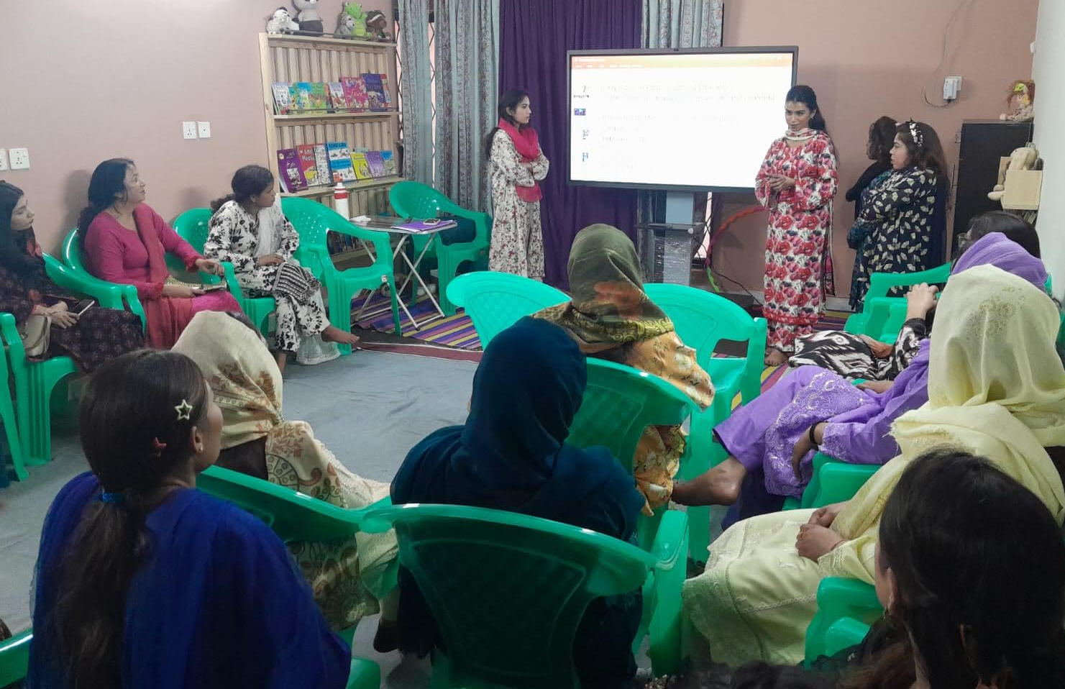

Slide 8

68 Schools,
7,635 Children
received more than books, they received a reason to dream, a chance to learn, and hope for a brighter tomorrow.

Slide 9
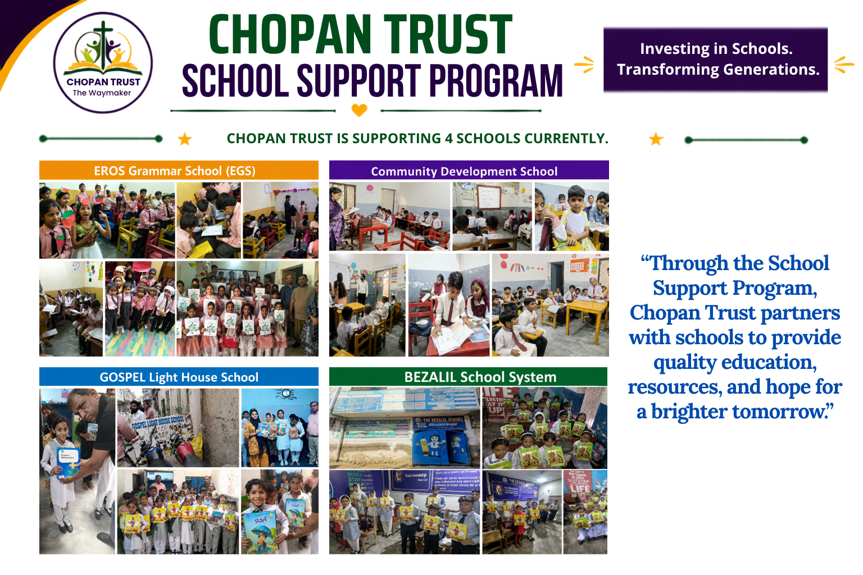

Slide 10


Slide 11

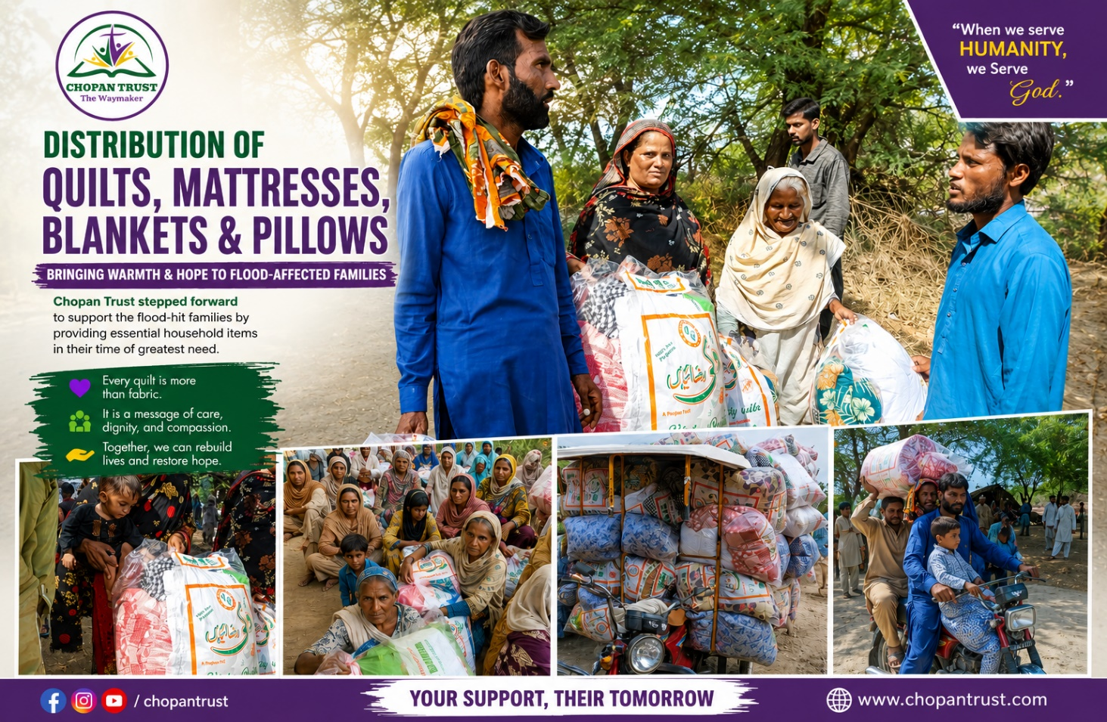

336 Families were given Quilts, Mattresses, Pillows and Blankets by Chopan Trust, 200 Families were given Cash Rs. 2,000/- per family. Emergency Relief food package were given to 62 families at different Bricklin

Slide 12

2286 People were given medicine in Chopan Trust Free Medical Camps, 7500 Sanitizers Distributed among 62 community schools

Slide 13


Slide 14


Slide 15
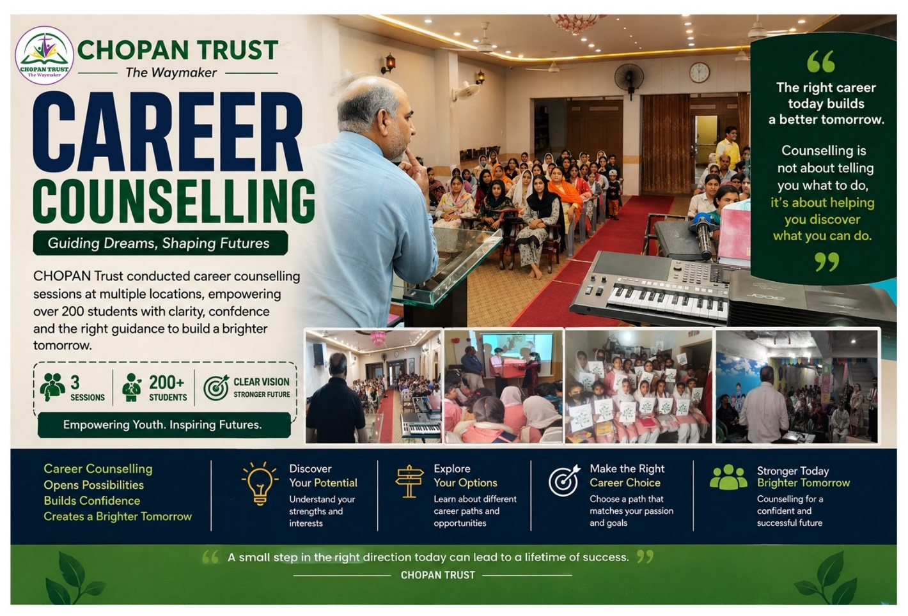
200 Students, 3 Sessions
Shaping their Future, Guiding their Dreams, to Rule the world

Slide 16


